Slide 1
Medicare Risk Adjustment
Can we predict chronic conditions gone undiagnosed?

Slide 2
Problem Statement
Can we predict the existence of a chronic health condition for a patient based on known test results NOT related to specific condition we are trying to predict and all other diagnosis related information for the patient?
Healthcare costs are extremely high
Preventative medicine is key to optimal patient care
Being able to predict probability of a patient having a condition based on their current portfolio of diagnosed conditions to expedite process

Slide 3
Data
Data ranges from 2014-2017
Indicators for the existence of all Hierarchical Condition Categories
HCC’s are all confirmed by medical professionals
Prevalence of each condition on average across 4 years is as follows:
Diabetes with Complications (HCC 18) = 42%
Morbid Obesity (HCC 22) = 19%
COPD - Chronic Obstructive Pulmonary Disease (HCC 111) = 29%
Neuropathy (HCC 75) = 11%

Slide 4
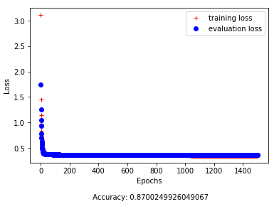


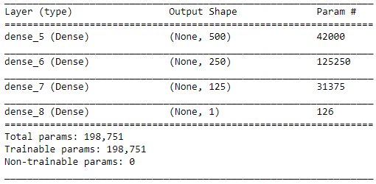
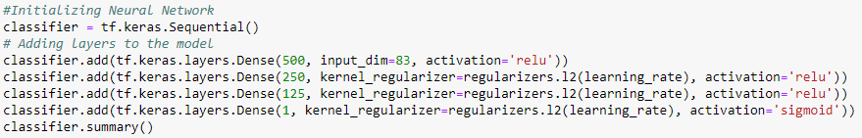
Diabetes with Complications (HCC 18)
What is the disease?
Diabetes with some complication that compounds the difficulty of treating the disease
Leads to problems in Eyesight, feeling in extremities, kidney disease, cardiovascular complications, skin conditions and other issues
PPV: 96.99%__ _
Notes:
Diabetes with some complication that compounds the difficulty of treating the disease
Eyesight, feeling in extremities, kidney disease, cardiovascular complications, skin conditions and other issues
Overall model accuracy/loss
Training: 87.04% / 0.3501
Validation Set : 86.76% / 0.3619
Final Test Set: 81.33%
Prevalence of 43% in the Final Test population

Slide 5
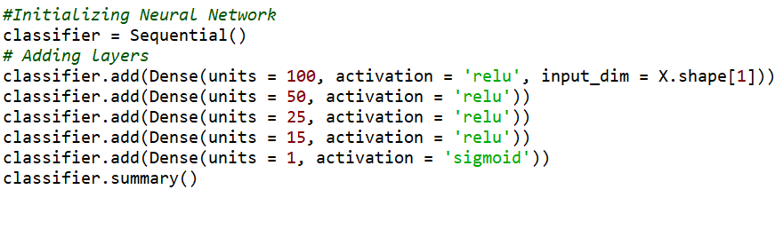
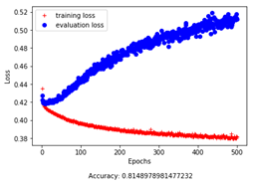
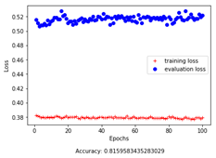
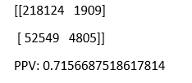
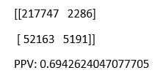
Morbid Obesity (HCC 22)
Alternatives tried: Regularization (L1,L2), Shallow network, Deep network, Wide network, All-Zero rows removed
What is the disease?
Diagnosed as having a Body Mass Index (BMI) of 40 or greater.
Has high risk of causing Type 2 Diabetes, cardiovascular illnesses, and much more
29% - 37% prevalent in population, in our data, only average of 19% by year
Larger (500) epoch model:
Smaller (100) epoch model:
Notes:
Description:
https://www.urmc.rochester.edu/highland/bariatric-surgery-center/questions/morbid-obesity.aspx
Overall accuracy:
81.49% Large
81.59% Small
PPV:
71.56% Large
69.42% Small
Fails to perform significantly above baseline, training set had 19% prevalence and test set had 20% prevalence). Indicates failure to learn.
Rapid divergence indicates powerful overfit, but when decreased to inflection point in epochs, model fails to converge in training vs eval.
Unlike Diabetes, which has many correlate conditions within the dataset, this condition does not correlate well, and there is essentially no signal for the network to uncover.
While all the models tried had some fluctuation around baseline probability, none were sufficiently successful in diagnosing the condition based on the other conditions.
Unlike some of the others we tested, this does not pose a functional issue: Morbid Obesity is very easy to diagnose in practice, and does not require or benefit from an approach such as these models.

Slide 6

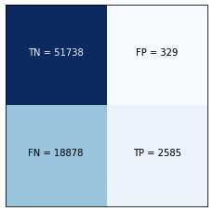
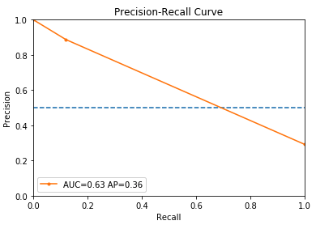
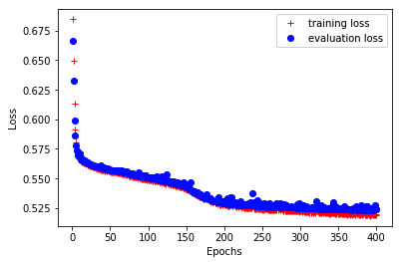
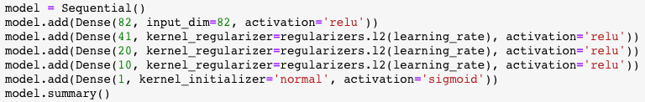
Chronic Obstructionary Pulmonary Disease (HCC 111)
What is the disease?
A chronic lung disease that makes it hard to breathe
Includes chronic bronchitis and emphysema
Third leading cause of death in the U.S.
Topology and model results
PPV: 88.70%__ _
Notes:
Precision: How many COPD predictions are actually COPD? TP/(TP+FP)
Recall: How many COPD dx can model identify? TP/(TP+FN)

Slide 7
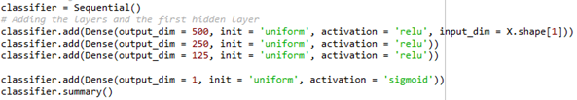

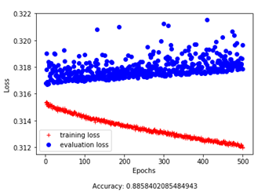
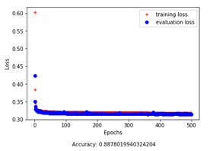


Neuropathy (HCC 75)
What is the disease?
Weakness, numbness, and pain from nerve damage
Damage is normally irreversible
Treatment revolves around mitigating damages
PPV: 59.09%
PPV: 67.24%

Slide 8
Conclusion & Next Steps
Models built using only basic demographics and other medical conditions as predictors are not guaranteed to find relevant signal in predicting a given condition. Many other factors at play that are not considered here.
For those conditions which correlate strongly, models like this can be a useful tool and should be refined to provide best possible care and diagnosis to patients
For conditions which are more easily diagnosed in other ways, or correlate poorly with other condition flags, alternative methods should be sought.

